Slide 1

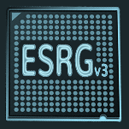



Trustable Machine Learning Development for Edge Devices
PhD Student
Miguel Costa @ ESRGv3, University of Minho, PT
PhD Supervisors
- Sandro Pinto @ ESRGv3, University of Minho, PT
- Adriano Tavares @ ESRGv3, University of Minho, PT
- Fausto Giunchiglia @ Dep. of Inf. Eng. and Comp. Science,
University of Trento, IT
ESRGv3

Slide 2
Background
Why is AI moving to the edge? Security problems in AI

Slide 3


Why is AI moving to the edge?
Due to the high computational power demanded by ML algorithms, ML workloads has predominantly been confined to cloud systems.
The amount of data generated by IoT devices will soon outpace the computational power of purely cloud-based systems and the bandwidth of available networks.
ESRGv3
3
Notes:
Cloud systems has powerful CPUs, GPUs, and ASICs.

Slide 4
Why is AI moving to the edge?
Due to the high computational power demanded by ML algorithms, ML workloads has predominantly been confined to cloud systems.
The amount of data generated by IoT devices will soon outpace the computational power of purely cloud-based systems and the bandwidth of available networks.
As Moore’s Law is ending, we can no longer rely on the rapid increase of computational power to address the challenges of next-generation ML systems.
ESRGv3
4

Slide 5
Why is AI moving to the edge?
Due to the high computational power demanded by ML algorithms, ML workloads has predominantly been confined to cloud systems.
The amount of data generated by IoT devices will soon outpace the computational power of purely cloud-based systems and the bandwidth of available networks.
As Moore’s Law is ending, we can no longer rely on the rapid increase of computational power to address the challenges of next-generation ML systems.
Ongoing trend to push intelligence to the edge
ESRGv3
5
Notes:
The cloud is delegated to model updates.
This novel paradigm aims at addressing the stringent requirements for real-time decision, alleviating the network congestion, and minimizing the energy consumption. Furthermore, it enables the deployment of IoT intelligent-applications in regions with an unreliable network

Slide 6

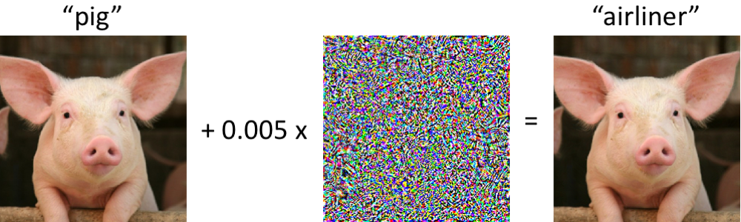
Security problems in AI
The integrity of the decision process is compromised if the system unknowingly renders decisions that the attacker wants
ESRGv3
6
Notes:
Integrity of the decision can be compromised by adversarial examples.

Slide 7
Security problems in AI
The integrity of the decision process is compromised if the system unknowingly renders decisions that the attacker wants
Attacks on confidentiality involve the extraction of information about the model, training data or user data
ESRGv3
7

Slide 8
PhD Context
Current Status

Slide 9
PhD Context
Goal #1
Design and devise a comprehensive threat model that systematizes the vulnerabilities of ML systems deployed in IoT edge devices, by establishing a roadmap between adversarial goals, attacks, and possible defenses.
This project aims at developing a trustable ML framework for lightweight Artificial Neural Networks (ANNs) running in low-end IoT edge devices
What are we doing?
Porting state-of-the-art ML models from the cloud to MCUs with Arm Cortex-M and RISC-V PULP architectures, using CMSIS-NN and PULP-NN APIs
Provide these APIs with support to Capsule Networks (state-of-the-art in image processing)
Exploring vulnerabilities in these edge ML models
ESRGv3
9

Slide 10
Can You Contribute?
MSc thesis proposals…

Slide 11
MSc Thesis Proposal #1
Develop a CapsNet pruning and tiling framework
Capsule Networks have recently overpassed convolutional neural networks in relevant image processing tasks
APIs for the deployment of neural networks in resource constrained MCUs, such as CMSIS-NN and PULP-NN, does not natively support capsule layers
We already provided CMSIS-NN and PULP-NN with support for capsules, but CapsNets can not be directly deployed in MCUs
MAIN GOALS:
Develop a state-of-the-art pruning technique for Capsule Networks
Reduce inference cost. Starting from a pre-trained network, the process is as follows: remove redundant parameters, retrain, and repeat while the test accuracy is under a given tolerance
Develop a state-of-the-art tiling technique for Capsule Networks
Data to be analyzed and model parameters are cut into smaller tiles which are progressively loaded into a smaller and faster memory, to address lack of memory problems.
Merge the developed tiling technique with the DORY framework, from RISC-V PULP, for a possible upstream
ESRGv3
11

Slide 12
MSc Thesis Proposal #2
Develop a framework towards explainable ANNs
The black-box quality of ANNs is delaying the adoption of AI in critical systems
Understanding which features were more relevant in a decision is a step towards the interpretability of ANNs and, consequently, the adoption of AI in mission-critical systems
MAIN GOALS:
Survey current algorithms for feature importance interpretation
If you find these are not good enough, we can develop a new one…
Port the previously selected/developed algorithm to a ready-available API for the execution of ANNs on the edge (CMSIS-NN, PULP-NN)
ESRGv3
12
Notes:
The acceptance and sustainable development and application of AI depends on the ability to understand, verify and explain the functioning, actions and decisions of AI systems

Slide 13
THANK YOU!
ANY QUESTIONS?
miguel.costa@dei.uminho.pt

